Slide 1
introduction
about me
gallery
Ex-shanshow
Hello!
Welcome to my website!
I wish you’ll pleased here.
Have fun!
You may interest in…
Context
ccccccccccccccccccccccccccccccccccccccccccccccccccccccccccccccccccccccccccccccccccccccccccccccccccccccccccccccccccccccccccccccccccccccc
Copywrong by E-shanshow

Slide 2
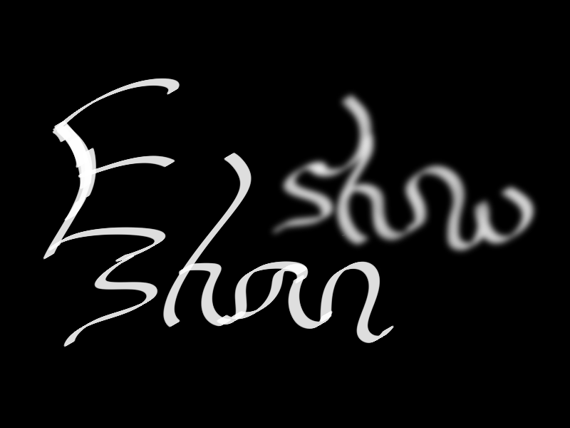

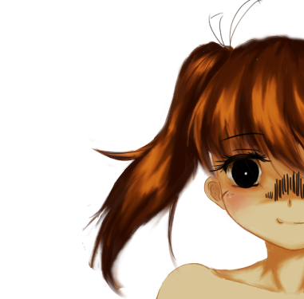






introduction
about me
gallery
Ex-shanshow
*Warning:
FBI is watching you.
Hello!
Welcome to my website!
I wish you’ll pleased here.
Have fun!
You may interest in…
Context
ccccccccccccccccccccccccccccccccccccccccccccccccccccccccccccccccccccccccccccccccccccccccccccccccccccccccccccccccccccccccccccccccccccccc
Copywrong by E-shanshow

